Slide 1

DATABREW’S
E-COMMERCE
INVENTORY
MANAGEMENT SYSTEM
GROUP PRESENTATION
CINS 5305
DR. MARY KIM

Slide 2





THE DATABREW TEAM
We the biggest!
Samson
Trudy-Ann
Oluwayemisi
Chinagolum
Chukwudi
Eromonsei
Campbell
Alabi
Osasah
Eze
Notes:
Links:

Slide 3
AGENDA
01
About the Project
02
Project Scope
03
Business Questions & Our ERD
04
DBMS, Stored Procedures and Trigger Function
05
Web Application

Slide 4
ABOUT THE PROJECT
A
INTRODUCTION
An e-commerce inventory management system allows businesses to manage and track inventory levels, orders, and sales across various online channels. It plays a crucial role in the success of e-commerce businesses by helping them avoid stockouts, reduce overstocking, and maintain accurate inventory counts.
PROBLEM STATEMENT
B
The current inventory management processes are manual and inefficient, resulting in stockouts and overstocking, which in turn leads to lost sales and increased costs. This inefficiency is caused by a lack of real-time data and an automated inventory tracking control system, resulting in operational inefficiencies. High error rates in inventory counting also have a negative impact on the customer experience on ecommerce platforms. Therefore, an automated inventory management system is required to enhance inventory accuracy, increase sales, and reduce costs
C
MISSION STATEMENT
D
Our mission is to provide an updated inventory online platform through an innovative and reliable inventory management system that streamlines our operations and drives growth and enhances our ability to make data-driven decisions for optimal inventory levels, reduce costs and improve other operational efficiency.

Slide 5
PROJECT SCOPE
The project involves the design of a one page frontend Web application and backend which powers the inventory management system.
The system will rely heavily on the frequent user purchase behavior on the front-end to drive inventory deductions at the backend which can be automated at certain thresholds.
Creation of an ERD, and an ecommerce database.
Creation of stored procedures and triggers functions.
Using PHP, HTML, MYSQL, and AJAX.
The inventory management system will improve customer experience, drive growth opportunities for business and can be scaled as business expands.

Slide 6
BUSINESS QUESTIONS
UR 1
What is the total number of stocks by product categories?
How many products have been sold by categories sorted by date?
UR 2
Our clients are operational staff
and management
UR 3
When a user checks out a product, there will be an update operation on the target table.
A query that returns a list of stocks below a specified threshold.
UR 4
UR 5
A query to check the minimum and maximum number of purchases done by customers.
A query to check top ten products sold.
UR 6
UR 7
A query that shows the bottom ten products.
Customer segmentation by gender.
UR 8
UR 9
A query that returns customer recency to our platform
A query that returns sales of product by state order from Highest to lowest.
UR 10

Slide 7
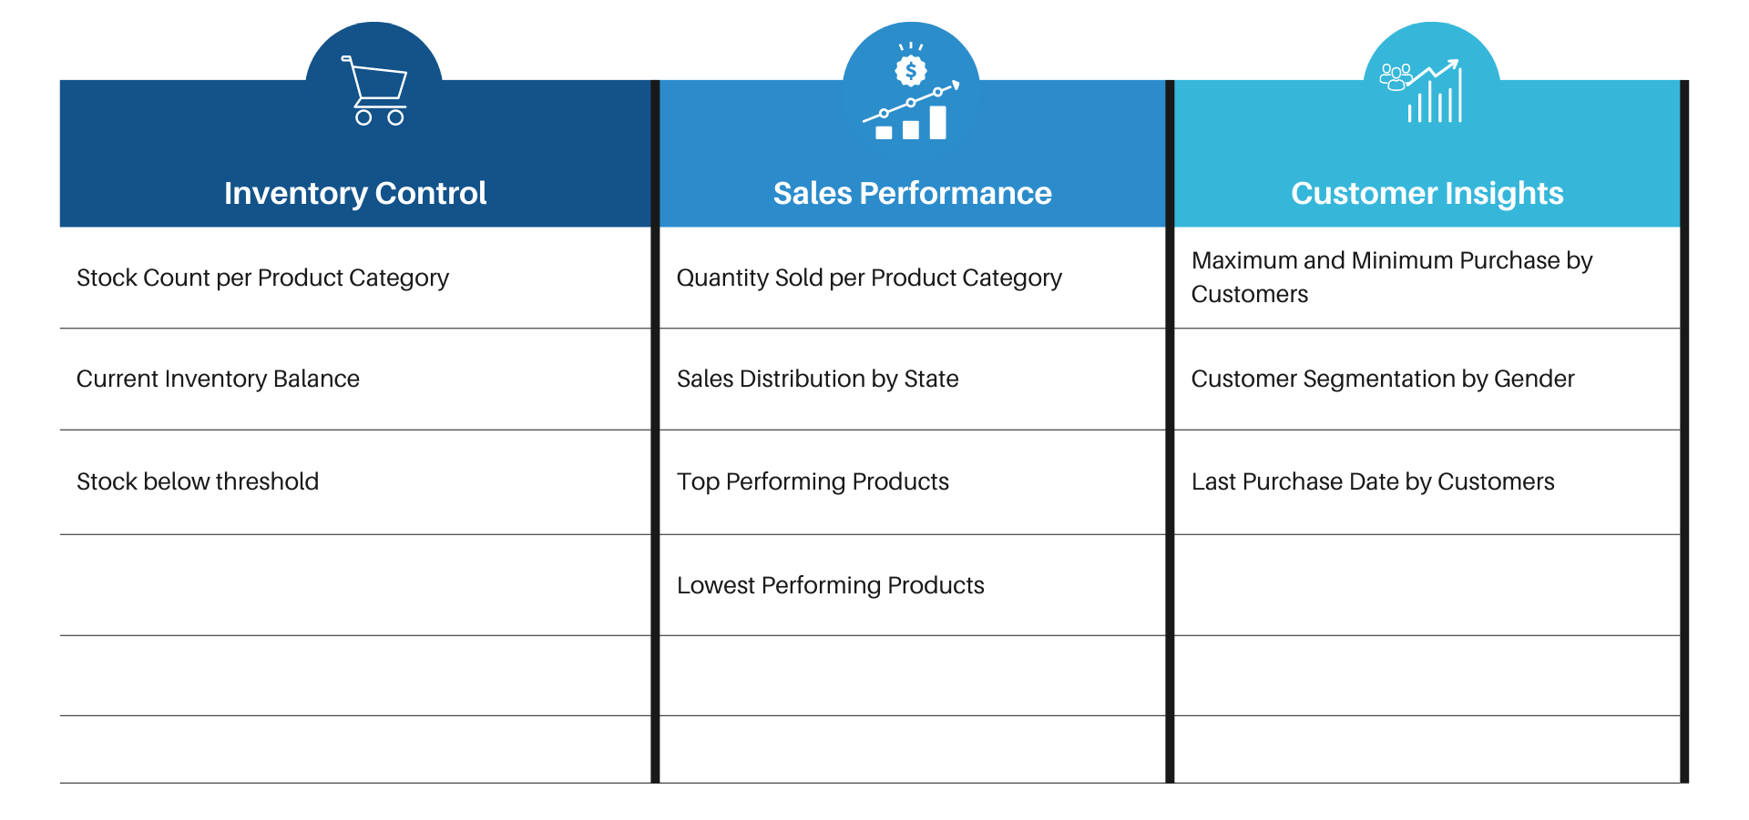
BUSINESS QUESTIONS

Slide 8
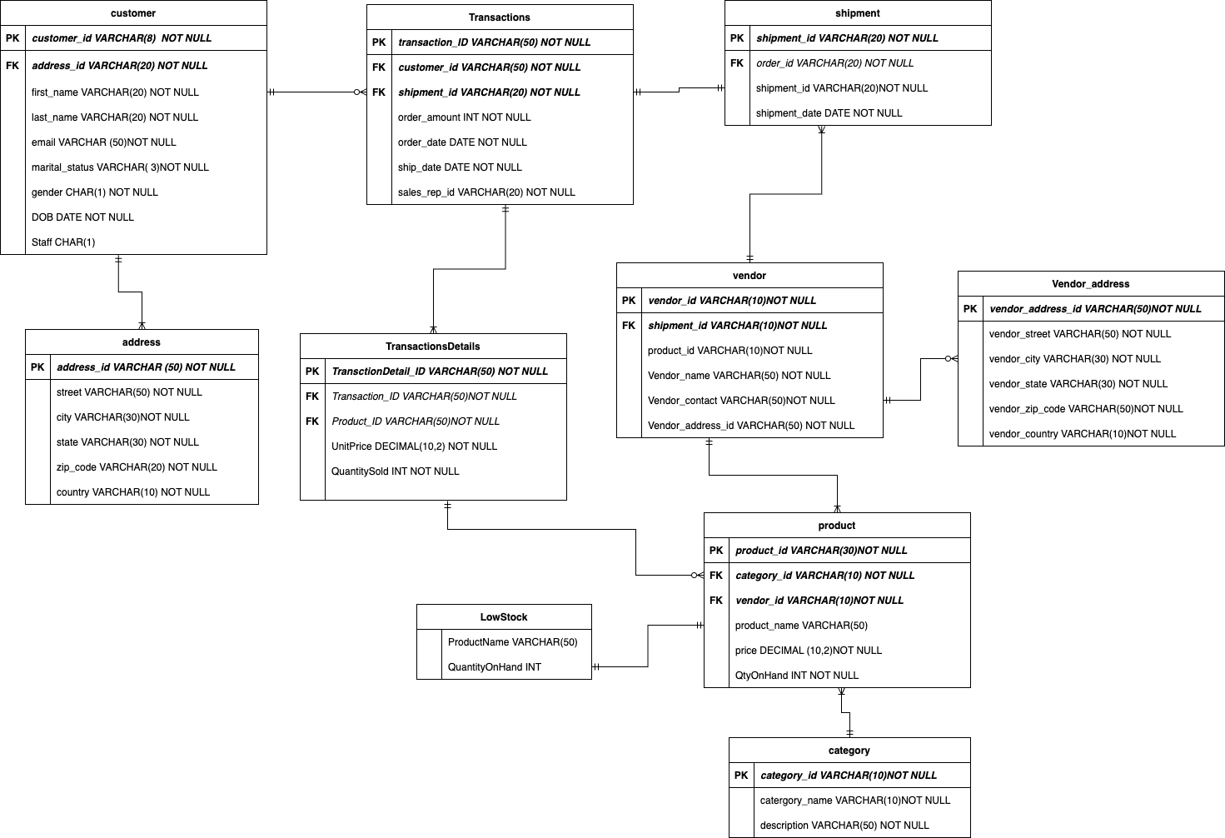

ENTITY RELATIONSHIP DIAGRAM (ERD)

Slide 9
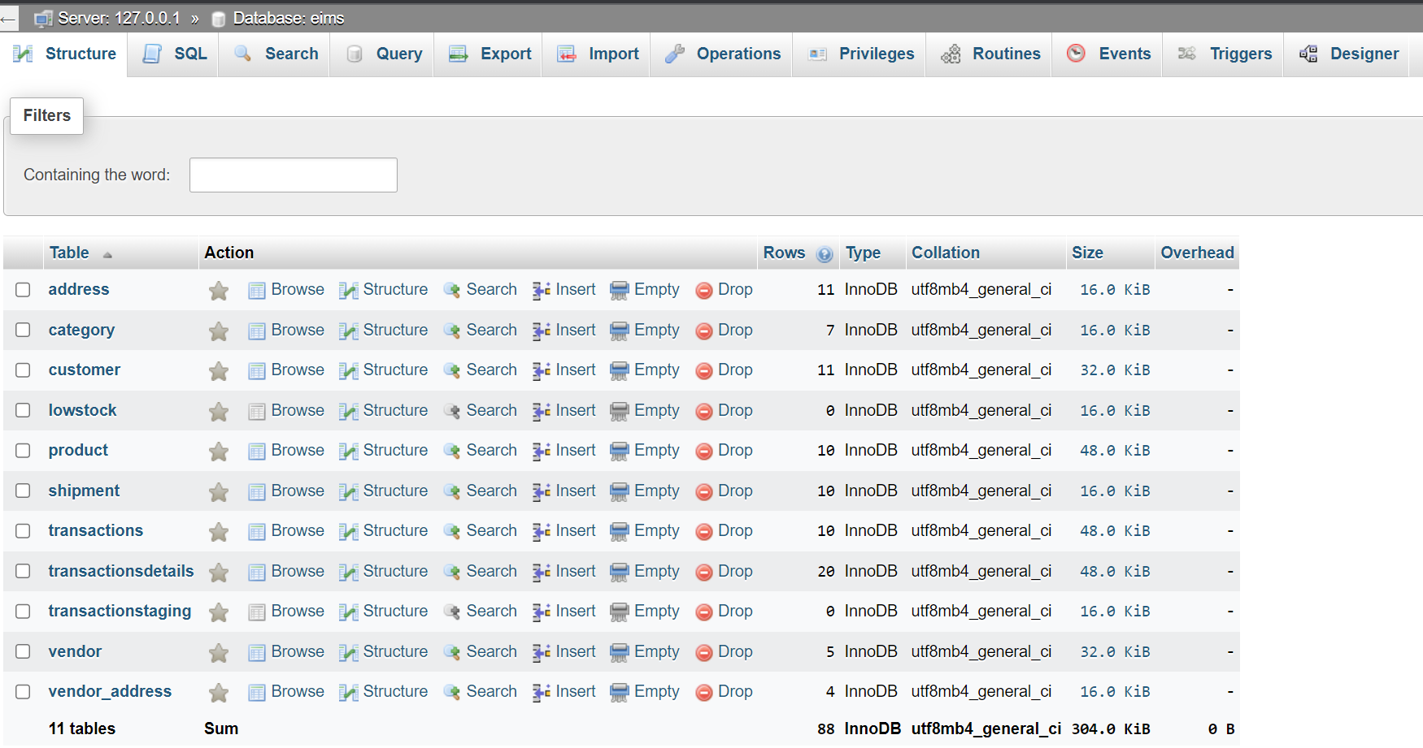
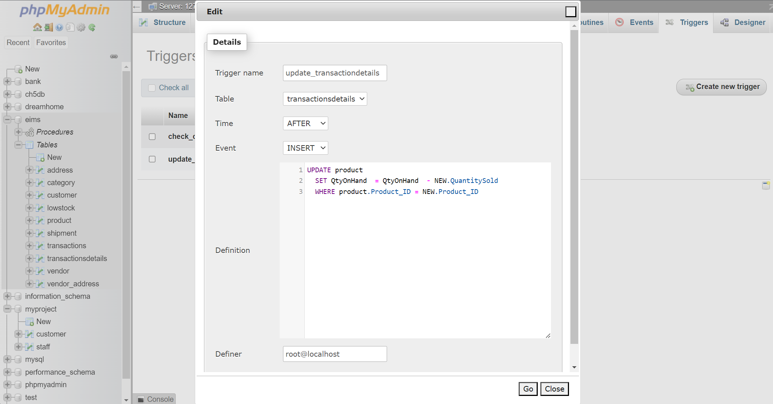
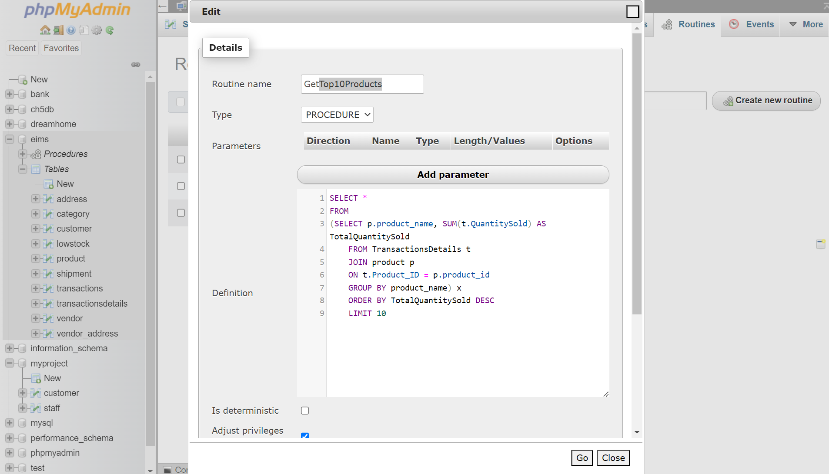
DBMS , STORED PROCEDURE & TRIGGER FUNCTION
DBMS VIEW
TRIGGER VIEW
SPROCD VIEW

Slide 10
DEMO TIME
STORED PROCEDURES
TRIGGER
An MYSQL statement that can be executed multiple times with a single call.
An MYSQL statement that executes in response to certain events, such as a data modification.

Slide 11
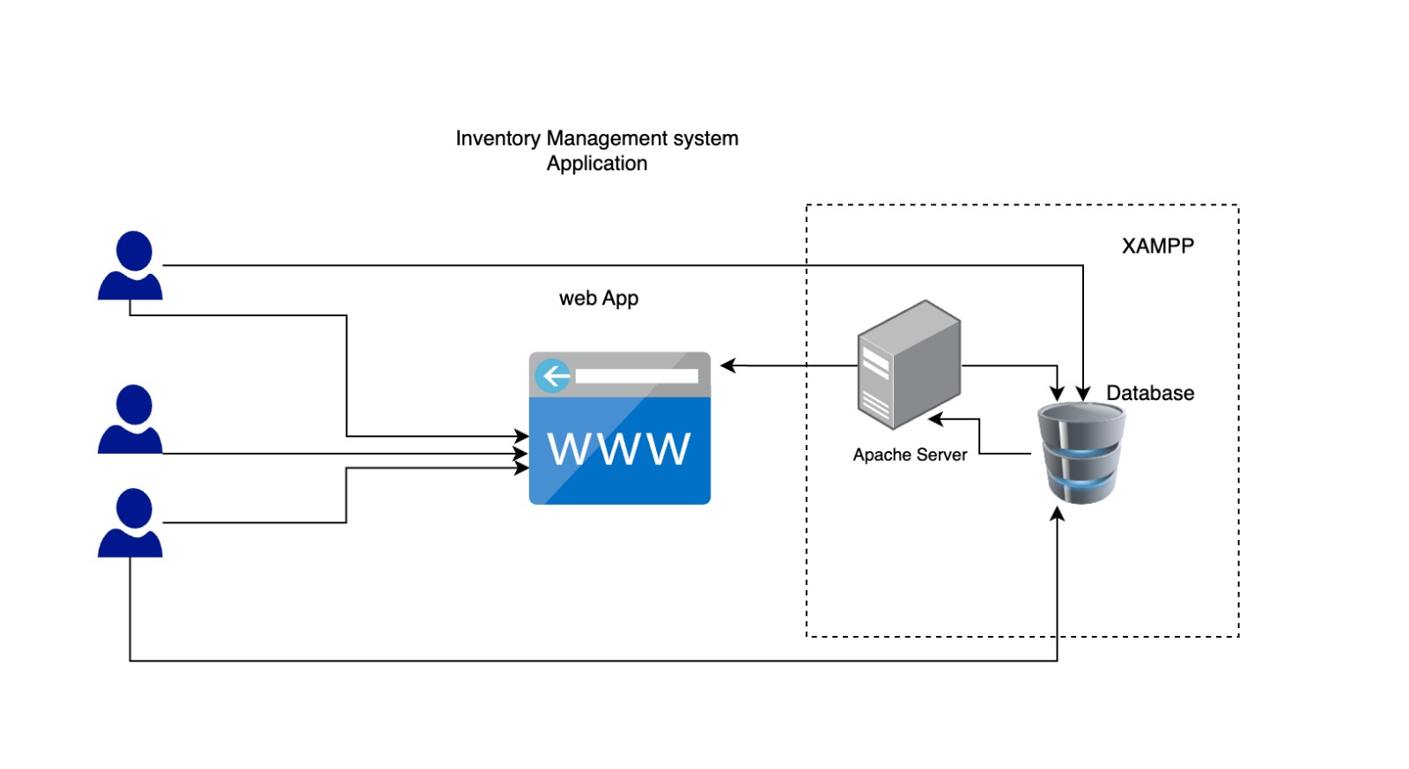
WEB APPLICATION ARCHITECTURE

Slide 12

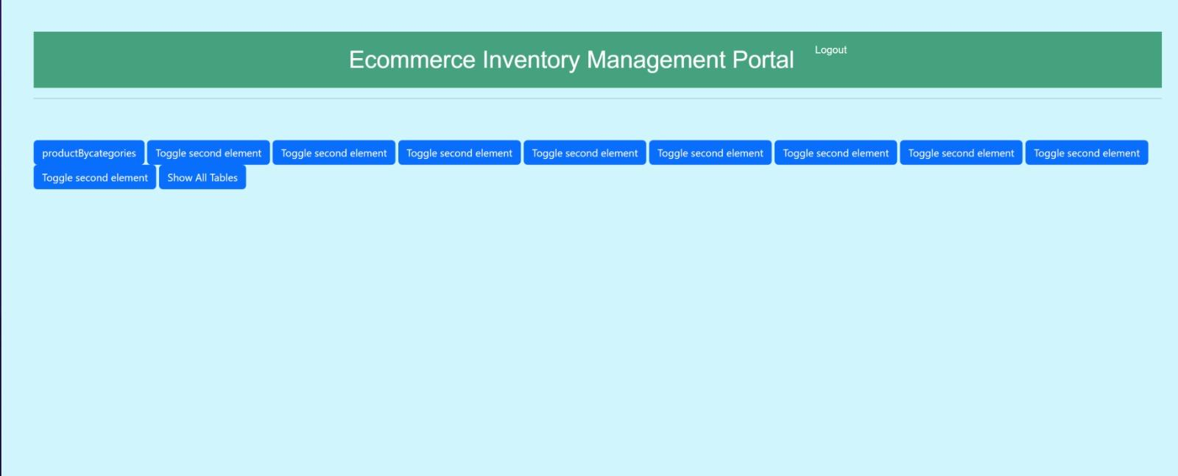
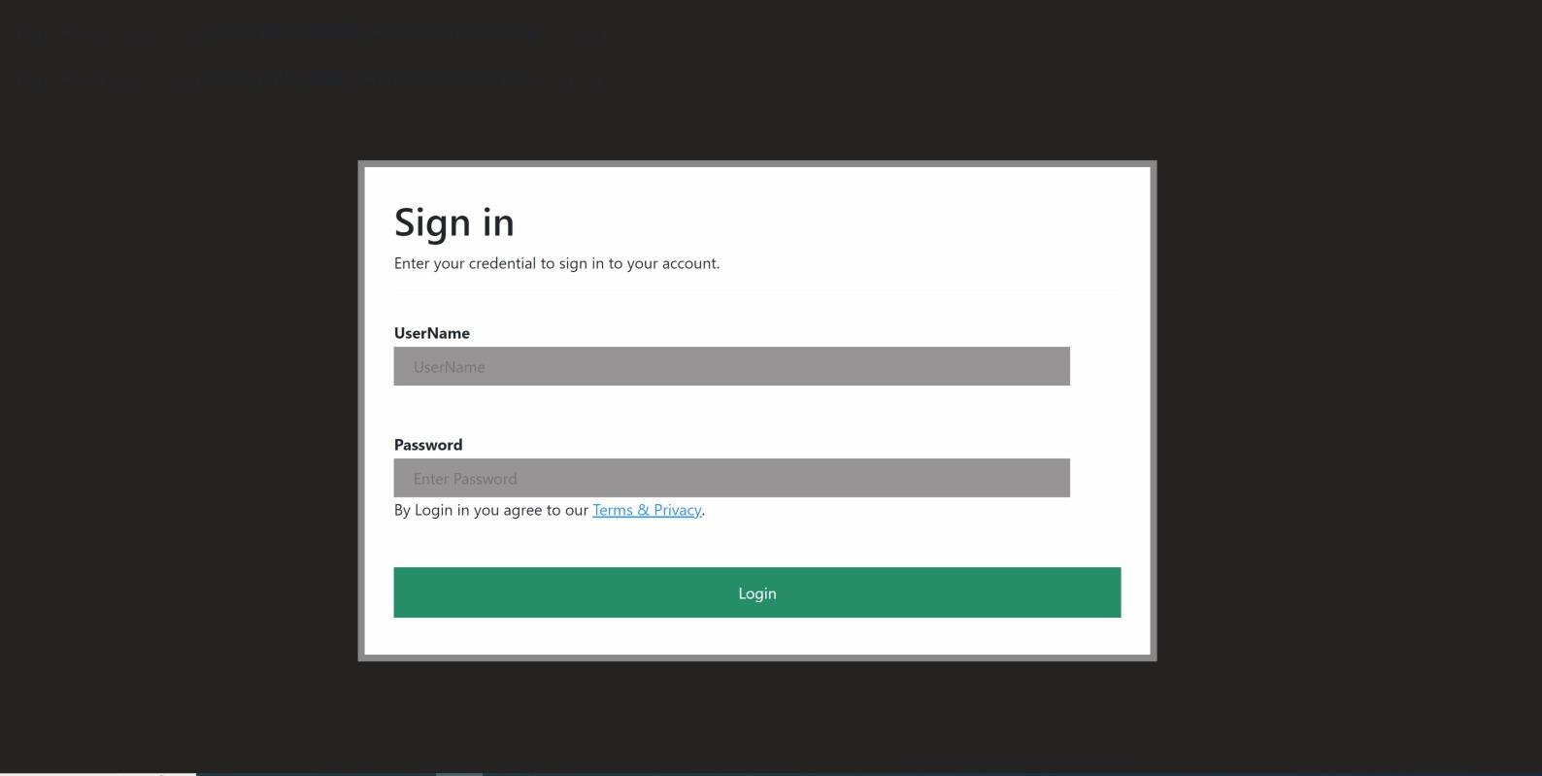
DATABREW WEB APPLICATION
Landing Page
360 view
Login Page

Slide 13
DEMO TIME
WEB APPPLICATION
A walkthrough of our website application, its features and functionalities.

Slide 14
CONCLUSION
The EIMS was developed utilizing SQL and PHP programming languages,
a powerful inventory management system that can benefit a wide range of businesses, which possess certain advantages and drawbacks. Among the strengths of this combination are its scalability, consistency, and latency. However, it is crucial to carefully consider the complexity of the products being sold before deciding about utilizing this pairing for an ecommerce enterprise.

Slide 15
PROJECT TIMELINE
Deployment
6
Final presentation of deliverable
1 day
Testing
5
Unit Testing
Functional Testing
4 days
Implementation
4
DB implementation
User – Interface
Implementation
3 weeks
Design & Development
3
DB design
Table design
ER diagram
2 weeks
2
Requirement Definition
Table Design
ER Diagrams
1 week
Project kickoff
WE THE BIGGEST…
DATABREW DID!
1
Research
Topic Selection
1 week

Slide 16
DATABREW SAYS
THANK YOU

